Slide 1
Web Programming 1
Worksheet 3

Slide 2
Favourite Movie Application
Create a new angular application called ‘movie-list’
ng new movie-list
Within app.component.ts create an array of your favourite movies
The array will have id, title, year & director
Have at least 3 movies (following slide)
Within app.component.html
add *ngFor loop to display movie details (following slide +1)
Run your application
ng serve

Slide 3
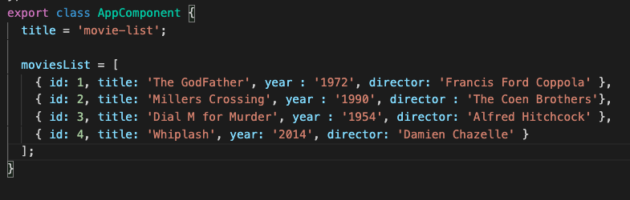
app.component.ts
Syntax for array of objects

Slide 4
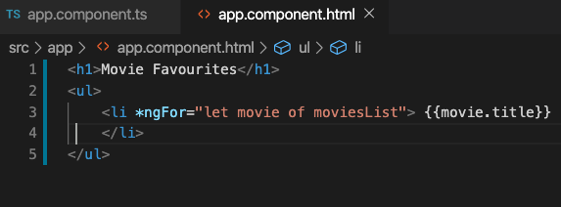
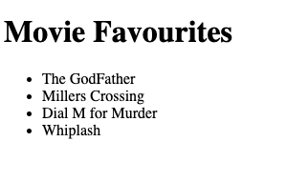
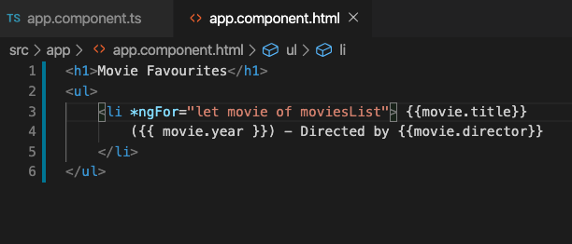
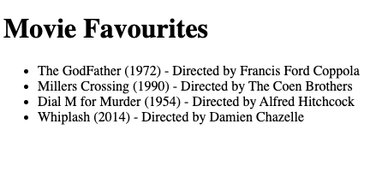
app.component.html

Slide 5
Improvements
Going to separate our data from the view component
Our Data should exist in services

Slide 6
Services & Dependency Injection
We now need to generate a new movie service
Go to terminal window
ng generate service movie
This will generate the following file automatically for us :
movie.service.ts (we will adjust this file to contain our movie array)

Slide 7
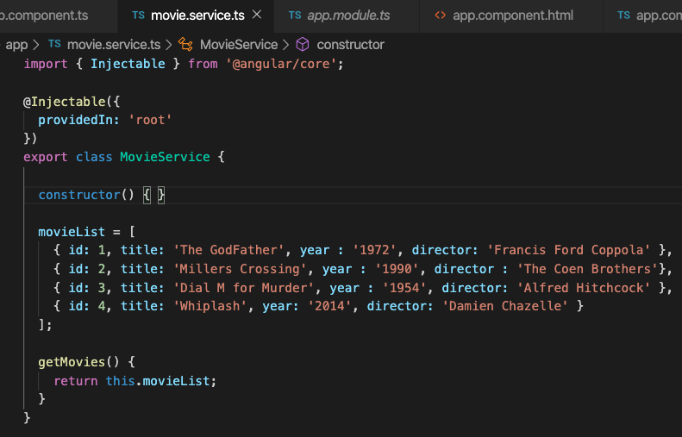
Specifying ‘root’ allows us to provide this
service in AppModule
Move our movie list array from app.component.ts
to movie.service.ts
We also create a method called getMovies() – this
will return data to app.component.ts

Slide 8
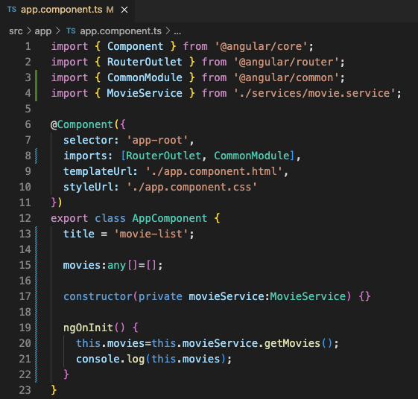
Within app.component.ts we first need to
import reference to our movie service
Declare an array called movies – you may need
To declare this as movies={} as any if it causes an error
Declare the movieService in the constructor
Of AppComponent
Finally add this code within ngOnInit()

Slide 9
I’ve made all the changes - but suddenly it doesn’t work..
Why is this?

Slide 10
Look to app.component.html
It still refers to moviesList
But this does not exist anymore!!
It should refer to movies!!
let movie of movies

Slide 11
Get ready to upload to Moodle
Add your name and student ID to the App
These should be visible in your browser window
Take a screenshot of the app up and running at localhost:/4200
Upload screenshot to your repo
Download zip from your repo
Upload this zip to moodle

